Slide 1
DynaMix: A New Take on Polymorphism
Borislav Stanimirov
Video game programmer

Slide 2
Hello, World
#include <iostream>
int main()
{
std::cout << "你好 I'm Borislav.";
return 0;
}

Slide 3
Borislav Stanimirov
Mostly a C++ programmer
Mostly a game programmer since 2006
Open-source programmer
Currently employed at Chobolabs

Slide 4
DynaMix: A New Take on Polymorphism

Slide 5
DynaMix: A New Take on Polymorphism

Slide 6
OOP and Polymorphism
OOP has come to imply dynamic polymorphism
Dynamic polymorphism is when the compiler can see a function call but can't know which actual piece of code will be executed next
It's in the category of things which are slower and can't have good compilation errors
Totally anti modern C++
OOP has been criticized a lot
OOP can be useful for business logic
People forget that C++ is an OOP language
Out of the box in an OOP context C++ only gives us virtual functions for polymorphism

Slide 7
C++ and Business Logic
Is C++ is a bad choice for business logic?
Many projects have chosen other languages: Lua, Python, JavaScript, Ruby…
C++ has poor OOP capabilities
You can hotswap
You can delegate to non-programmers
However:
The code is slower
There is more complexity in the binding layer
There are duplicated functionalities (which means duplicated bugs)

Slide 8
DynaMix: A New Take on Polymorphism

Slide 9
DynaMix: A New Take on Polymorphism

Slide 10
Polymorphism in Modern C++
Polymorphic type-erasure wrappers
Boost.TypeErasure, Dyno, Folly.Poly
using Drawable = Library_Specific_Magic;
struct Square {
void draw(std::ostream& out) const { out << "Square\n"; }
};
struct Circle {
void draw(std::ostream& out) const { out << "Circle\n"; }
};
void f(const Drawable& d) {
d.draw(std::cout);
}
int main() {
f(Square{});
f(Circle{});
}

Slide 11
Polymorphic Wrappers
Better than classic virtual functions
Information hiding (PIMPL)
Non-intrusive
More extensible
Potentially faster
… but more or less the same
Interface types
Implementation types
Basically improved virtual functions
Don’t seem compelling enough to ditch scripting languages

Slide 12
Other C++ Polymorphism
Signals/slots (Multicasts)
Very popular
Especially in GUI libraries (say Qt)
Boost.Signals2, FastDelegate, …
Multiple dispatch
collide(obj1, obj2);
Obscure feature
Relatively easy to mimic
Folly.Poly, yomm11
Functional programming libraries

Slide 13
DynaMix: A New Take on Polymorphism

Slide 14
DynaMix: A New Take on Polymorphism

Slide 15
DynaMix
Open source, MIT license, C++ library
github.com/iboB/dynamix
This talk is an introduction to the library
Focus on the what and why
Hardly even mention the “how”
There will also be a small demo
History
2007: Interface. Zahary Karadjov
2013: Rebirth as Boost.Mixin
2016: Bye, Boost. Hello, DynaMix

Slide 16

Earthrise

Slide 17
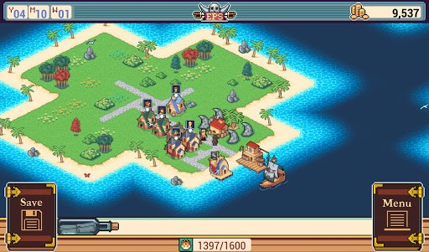
Epic Pirate Story 2

Slide 18

War Planet Online

Slide 19
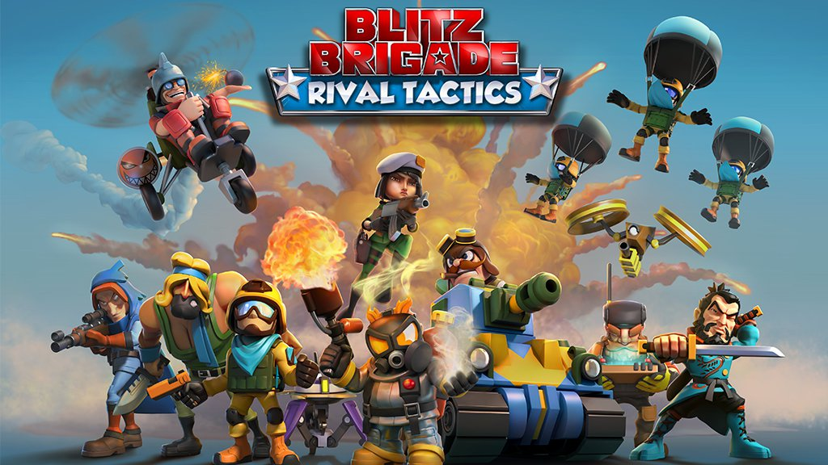
Blitz Brigade: Rival Tactics

Slide 20
What is DynaMix?
Not a physics library
Not even a game library
A new take on polymorphism
Compose and modify polymorphic objects at run time

Slide 21
Some Inspirational Ruby
module FlyingCreature
def move_to(target)
puts can_move_to?(target) ?
"flying to #{target}"
: "can't fly to #{target}"
end
def can_move_to?(target)
true # flying creatures don't care
end
end
module AfraidOfEvens
def can_move_to?(target)
return target%2 != 0
end
end
a = Object.new
a.extend(FlyingCreature)
a.move_to(10)
a.extend(AfraidOfEvens)
a.move_to(10)

Slide 22
DynaMix means “Dynamic Mixins”

Slide 23
Static (CRTP) Mixins
struct cd_reader {
string get_sound() const {
return cd.empty() ? "silence" : ("cd: " + cd);
}
string cd;
};
template <typename Self>
struct headphones {
const Self* self() const {
return static_cast<const Self*>(this);
}
void play() {
cout << "Playing " << self()->get_sound()
<< " through headphones\n";
}
};
struct diskman : public cd_reader, public headphones<diskman> {};
struct boombox : public cd_reader, public speakers<boombox> {};
struct ipod : public mp3_reader, public headphones<ipod> {};

Slide 24
Static Polymorphism with Mixins
template <typename Player>
void use_player(Player& player) {
player.play();
}
int main() {
diskman dm;
dm.cd = "Led Zeppelin IV (1971)";
use_player(dm);
ipod ip;
ip.mp3 = "Led Zeppelin - Black Dog.mp3";
use_player(ip);
}

Slide 25
DynaMix: The Gist
Building blocks
dynamix::object – just an empty object
Mixins – classes that you've written which actually implement messages
Messages – function-like pieces of interface, that an object might implement
Usage
Mutation – the process of adding and removing mixins from objects
Calling messages – like calling methods, this is where the actual business logic lies

Slide 26
DynaMix Sound Player
dynamix::object sound_player; // just an empty dynamix::object
dynamix::mutate(sound_player)
.add<cd_reader>()
.add<headphones_output>();
sound_player.get<cd_reader>()->insert("Led Zeppelin IV (1971)");
// play is a message
play(sound_player); // cant have sound_player.play() :(
// -> Playing CD "Led Zeppelin IV (1971)" through headphones
dynamix::mutate(sound_player)
.remove<headphones_output>()
.add<speakers_output>();
play(sound_player);
// -> Playing CD "Led Zeppelin IV (1971)" THROUGH SPEAKERS

Slide 27
Inevitable Boilerplate
Messages:
// In some header:
DYNAMIX_MESSAGE_0(string, get_sound);
DYNAMIX_MESSAGE_0(void, play);
DYNAMIX_MESSAGE_2(int, foo, float, f, string, s);
// In some compilation unit (.cpp):
DYNAMIX_DEFINE_MESSAGE(get_sound);
DYNAMIX_DEFINE_MESSAGE(play);
DYNAMIX_DEFINE_MESSAGE(foo);
We fully separate the interface from the implementation

Slide 28
Message vs Method
Late binding and Smalltalk

Slide 29
Boilerplate Continued
DYNAMIX_DECLARE_MIXIN(cd_reader);
DYNAMIX_DECLARE_MIXIN(headphones_output);
// That’s all we need to mutate
class cd_reader {
public:
string get_sound() {
return cd.empty() ? "silence" : ("CD " + cd);
}
void insert(const string& cd) {
_cd = cd;
}
string _cd;
};
DYNAMIX_DEFINE_MIXIN(cd_reader, get_sound_msg);
// ...
DYNAMIX_DEFINE_MIXIN(mp3_reader, get_sound_msg);

Slide 30
Referring to the owning object
class headphones_output {
public:
void play() {
cout << "Playing " << get_sound(dm_this)
<< " through headphones\n";
}
};
DYNAMIX_DEFINE_MIXIN(headphones_output, play_msg);
dm_this is like self: the owning object
No inheritance. The library is non-intrusive

Slide 31
DEMO TIME

Slide 32
When to Use DynaMix
When you're writing software with complex polymorphic objects
When you have subsystems which care about interface (rather than data. Otherwise use an ECS)
When you want plugins which enable various aspects of your objects
Such types of projects include
Most CAD systems
Some games: especially RPGs and strategies
Some enterprise systems

Slide 33
When NOT to Use DynaMix
DynaMix is a means to create a project's architecture rather than achieve its purpose
Small scale projects
Projects which have little use of polymorphism
Existing large projects
In performance critical code

Slide 34
Recap
Compose and mutate objects from mixins
Have uni- and multicast messages
Manage message execution with priorities
Easily have hot-swappable or even releasable plugins
There was no time for:
Custom allocators
Message bids
Multicast result combinators
Implementation details

Slide 35
Thank you!
Questions?
DynaMix is here: github.com/iboB/dynamix

Slide 36
Interface to Component
Object:
class object {
reader* _reader = nullptr;
player* _player = nullptr;
// ...
};
// compose
object sound_player;
auto r = new cd_reader;
r->cd = "Led Zeppelin IV (1971)";
sound_player.set_reader(r);
sound_player.set_player(new headphones);
// modify
sound_player.set_player(new speakers);
// use
sound_player.get_player()->play();

Slide 37
Interface to Component cont…
Component:
class component {
object* self;
};
class player : public component {
virtual void play() = 0;
};
struct headphones : public player {
virtual void play() override {
cout << "Playing " << self->get_reader()->get_sound()
<< " through headphones\n";
}
};

Slide 38
Interface to Component cont…
A pretty decent solution
Not to be confused with entity-component-system
Many games and CAD systems use it
You can recreate almost every feature of DynaMix. But:
In a concrete and nonreusable way
Every new type of interface needs to be explicitly added to the huge object class
Interfaces are limiting
No new interfaces in plugins

